Slide 1
Covid test and vaccination system.

Slide 2
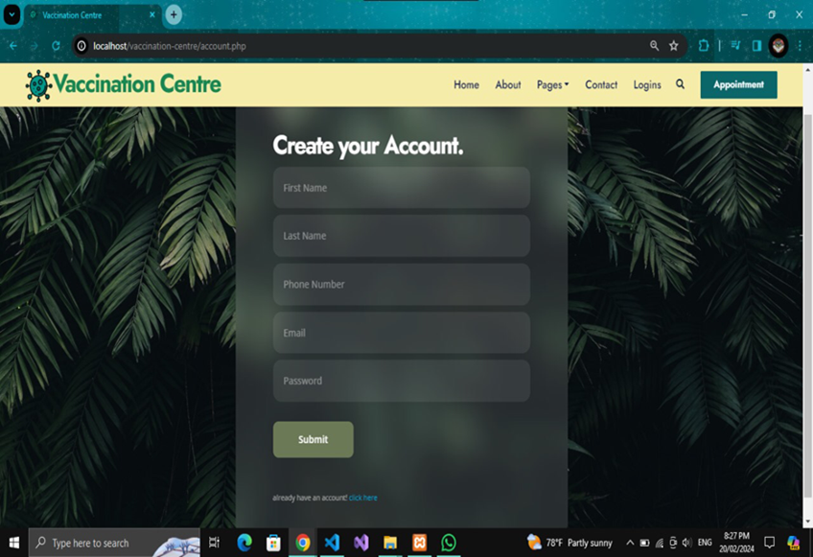
CREATE ACCOUNT

Slide 3
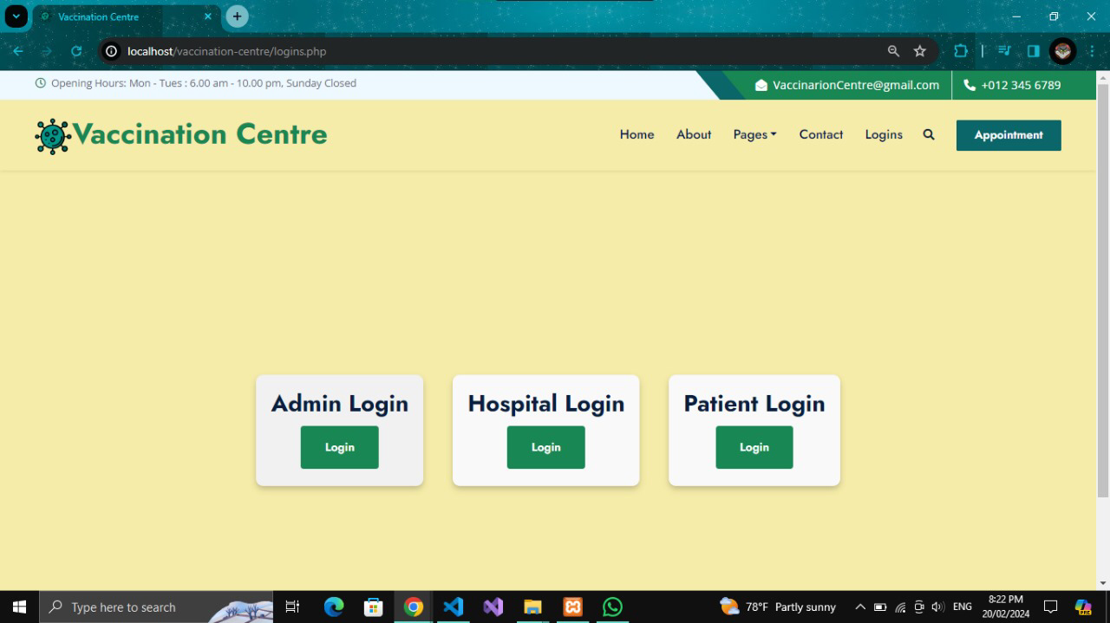
LOGIN PANEL

Slide 4
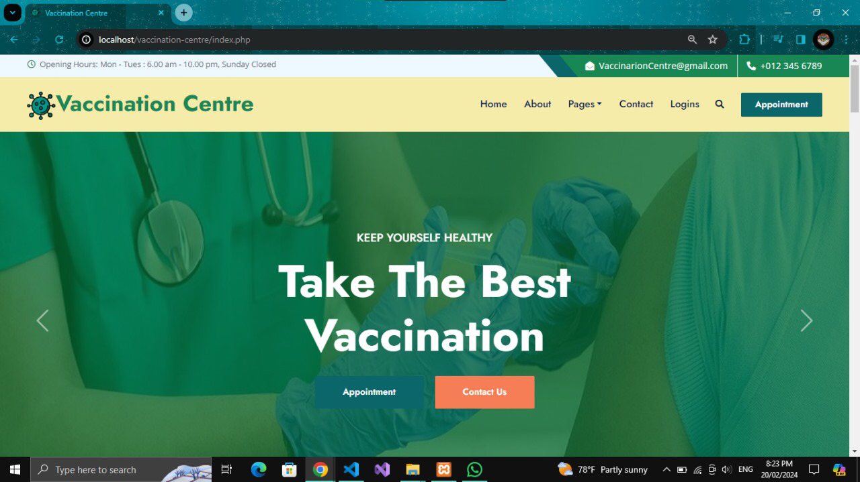
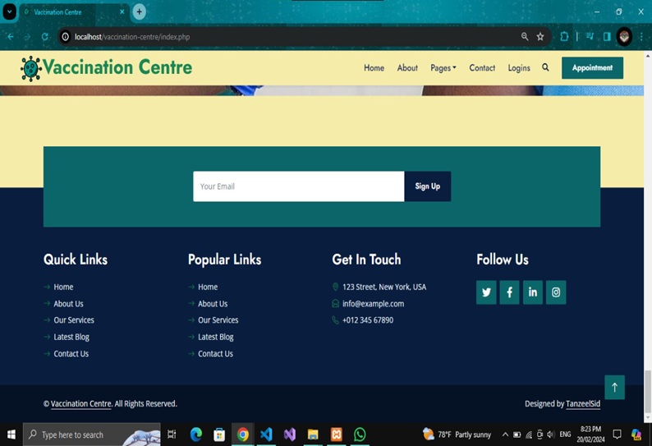
HOME PAGE

Slide 5
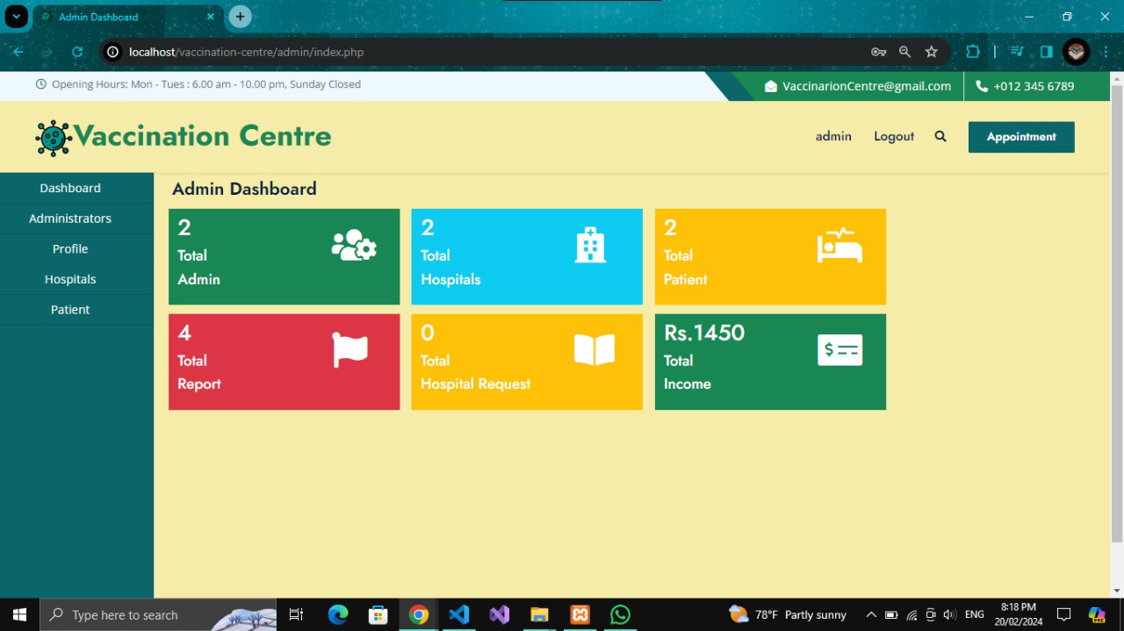
Admin dashboard

Slide 6
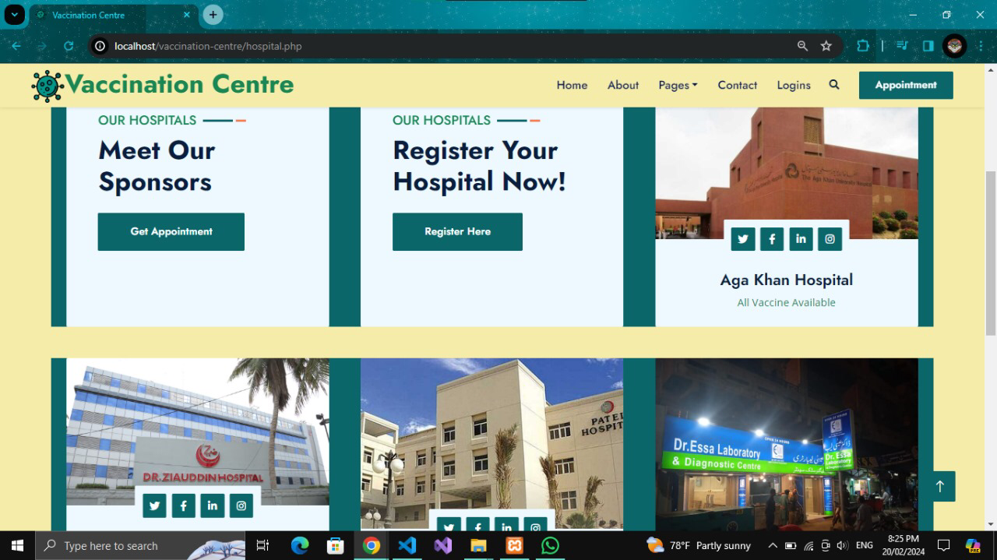
REGISTER FOR HOSPITAL

Slide 7

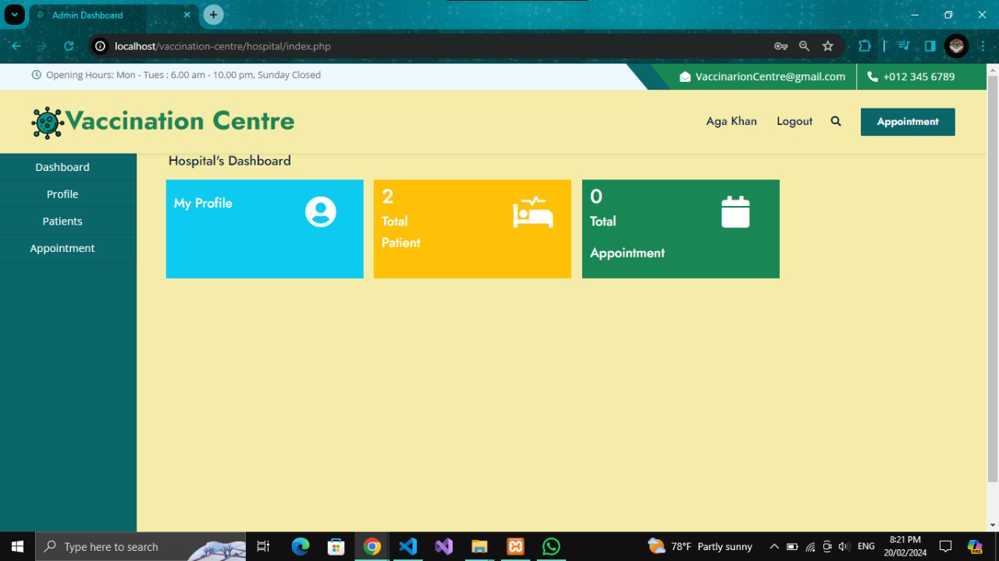
Hospital

Slide 8
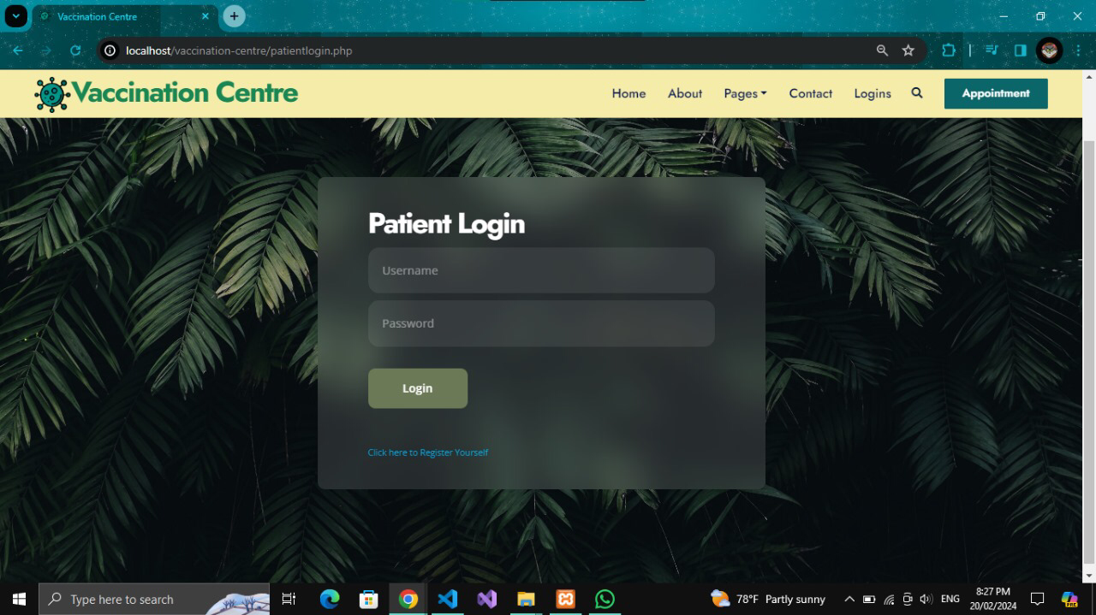
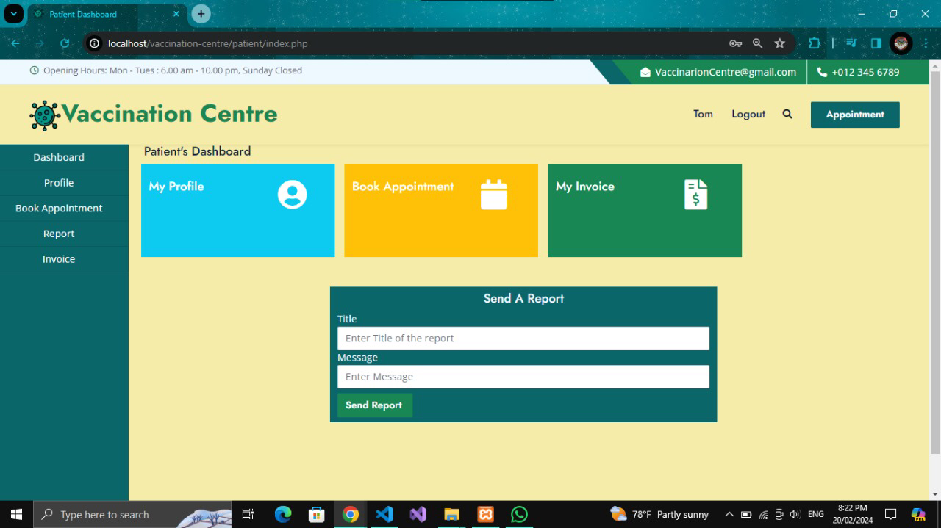
Patient:

Slide 9
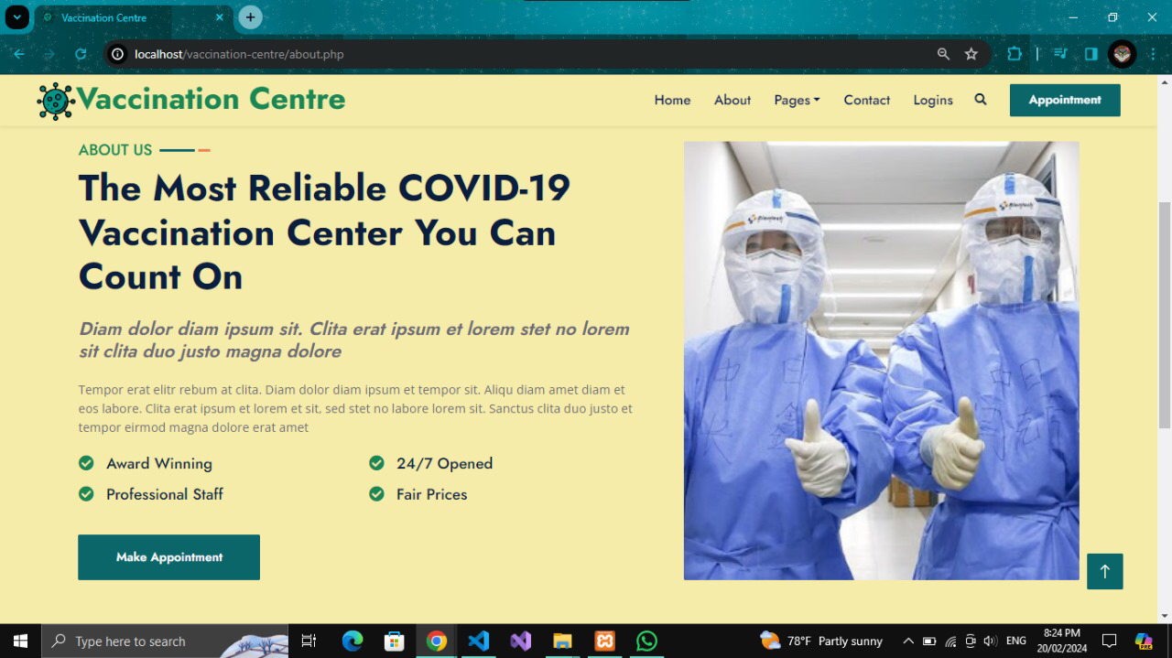
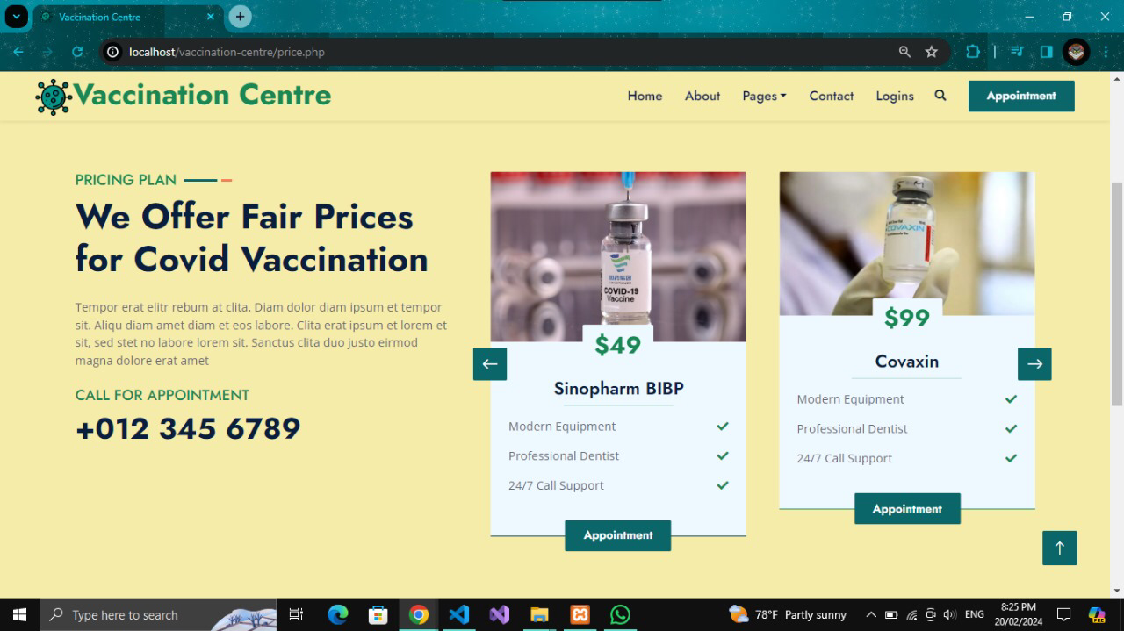
VACCINES

Slide 10
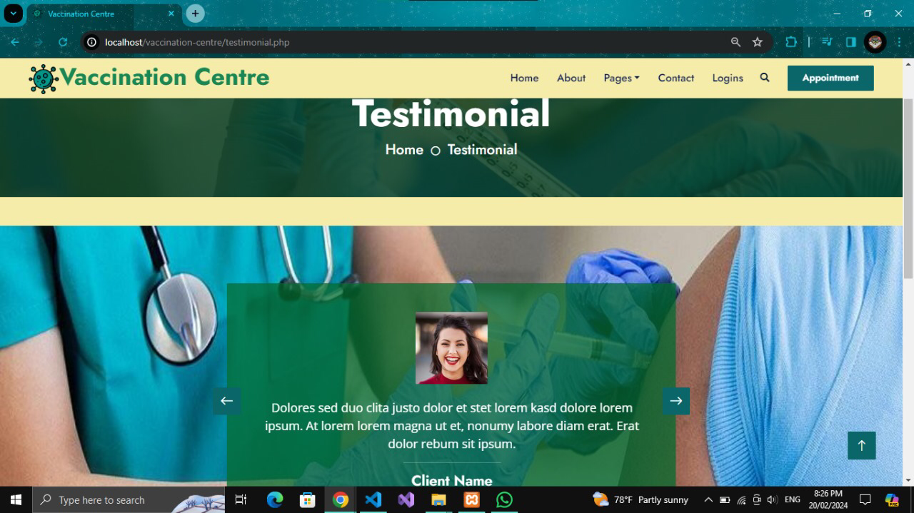
GET YOURSELF TESTED

Slide 11
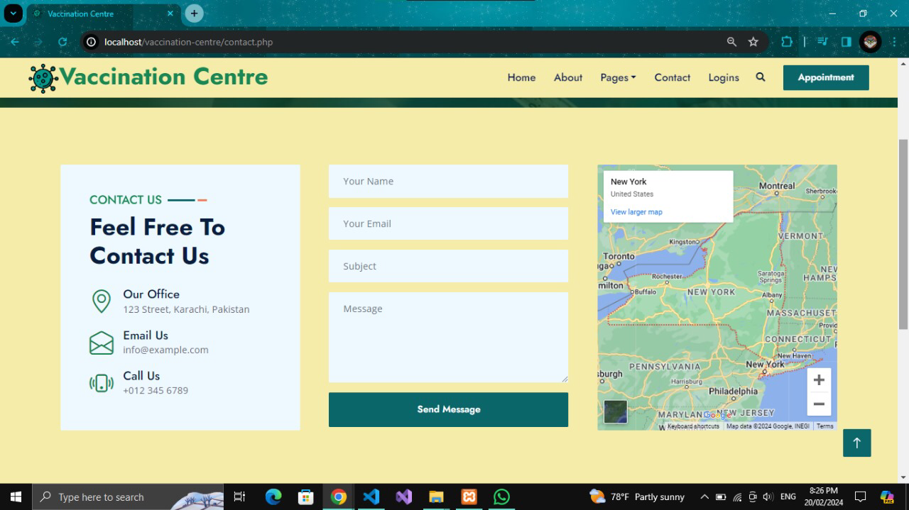
CONTACT US

Slide 12
THANKYOU!! WE HOPE YOU GUYS LIKED IT! ☺

